Slide 1



chapter 3
the interaction
Week 3 · Lecture 2
WIMP elements, interactivity, context, experience and value

Slide 2
How today’s lecture works
HOW TODAY WORKS
look for these badges in the top-left of a slide
POLL
Vote with your hands (1 or 2 fingers) — everyone answers, no one is wrong.
QUIZ
Answer on paper first; the next slide reveals the answer.
THINK-PAIR-SHARE
1 min alone → 2 min with your neighbour → a few pairs share.
LIVE EXERCISE
Do it now, in class, with the device or room around you.
CASE PUZZLE
A real system you use; apply the model to it in small groups.
Today: WIMP elements → interactivity → context → experience → physical design → value, with 13 short activities (~35 min; two are optional)
Have ready: a sheet of paper, your phone, and one everyday object (pen, remote, keys)
Notes:
Set expectations. The flow poll and the physical-design hunt are the easiest to drop if time is short.

Slide 3
Recap: three quick questions
QUIZ
2 min · last lecture in three questions — answer out loud
1
I can’t tell whether my fee payment went through. Which gulf?
a) execution
b) evaluation
c) neither
2
Typing a password with Caps Lock on is a…
a) slip
b) mistake
c) goal
3
An ATM’s numbered option list is which style?
a) command line
b) menus
c) natural language
Today: the elements of WIMP → interactivity → context → experience → physical design → value.
Notes:
QUIZ, 2 minutes, answered out loud as a class.
Answers: 1 evaluation (b), 2 slip (a), 3 menus (b).
If many get 1 wrong, spend one extra minute on 'how to do it' vs 'what happened'.

Slide 4
elements of the wimp interface
windows, icons, menus, pointers
+++
buttons, toolbars,
palettes, dialog boxes
also see supplementary material
on choosing wimp elements

Slide 5
Is WIMP dead on your phone?
THINK-PAIR-SHARE
3 min · take out your phone
Which of the four WIMP elements survived on your touch-screen phone — and what replaced the rest?
WIMP element
On your phone? What replaced it?
Windows
Icons
Menus
Pointers
Notes:
THINK-PAIR-SHARE, 3 minutes. Phones out, one minute of looking, two minutes comparing with a neighbour.

Slide 6
Is WIMP dead on your phone?
ANSWERS
what most pairs find
Which of the four WIMP elements survived on your touch-screen phone — and what replaced the rest?
WIMP element
On your phone? What replaced it?
Windows
Mostly gone: full-screen apps; split screen and the ‘recent apps’ cards remain
Icons
Everywhere — the home screen is a grid of icons
Menus
Became the three-line “hamburger” menu, long-press context menus and bottom sheets
Pointers
Your finger — no hover, so no tooltips, and targets must be bigger (Fitts, Week 1)
Loss of hover is the big one: every hint that a mouse gives for free must be designed in some other way on touch.
Notes:
Suggested answers. Ask: where do phones still use a real pointer? (Stylus, or a mouse plugged into a tablet — the cursor comes back.)
Link to Week 1: a fingertip is a fat, imprecise pointer, so Fitts' law says targets must grow.

Slide 7
Windows
Areas of the screen that behave as if they were independent
  can contain text or graphics
  can be moved or resized
  can overlap and obscure each other, or can be laid out next to one another (tiled)
scrollbars
  allow the user to move the contents of the window up and down or from side to side
title bars
  describe the name of the window

Slide 8
Icons
small picture or image
represents some object in the interface
  often a window or action
windows can be closed down (iconised)
  small representation ﬁ many accessible windows
icons can be many and various
  highly stylized
  realistic representations.

Slide 9
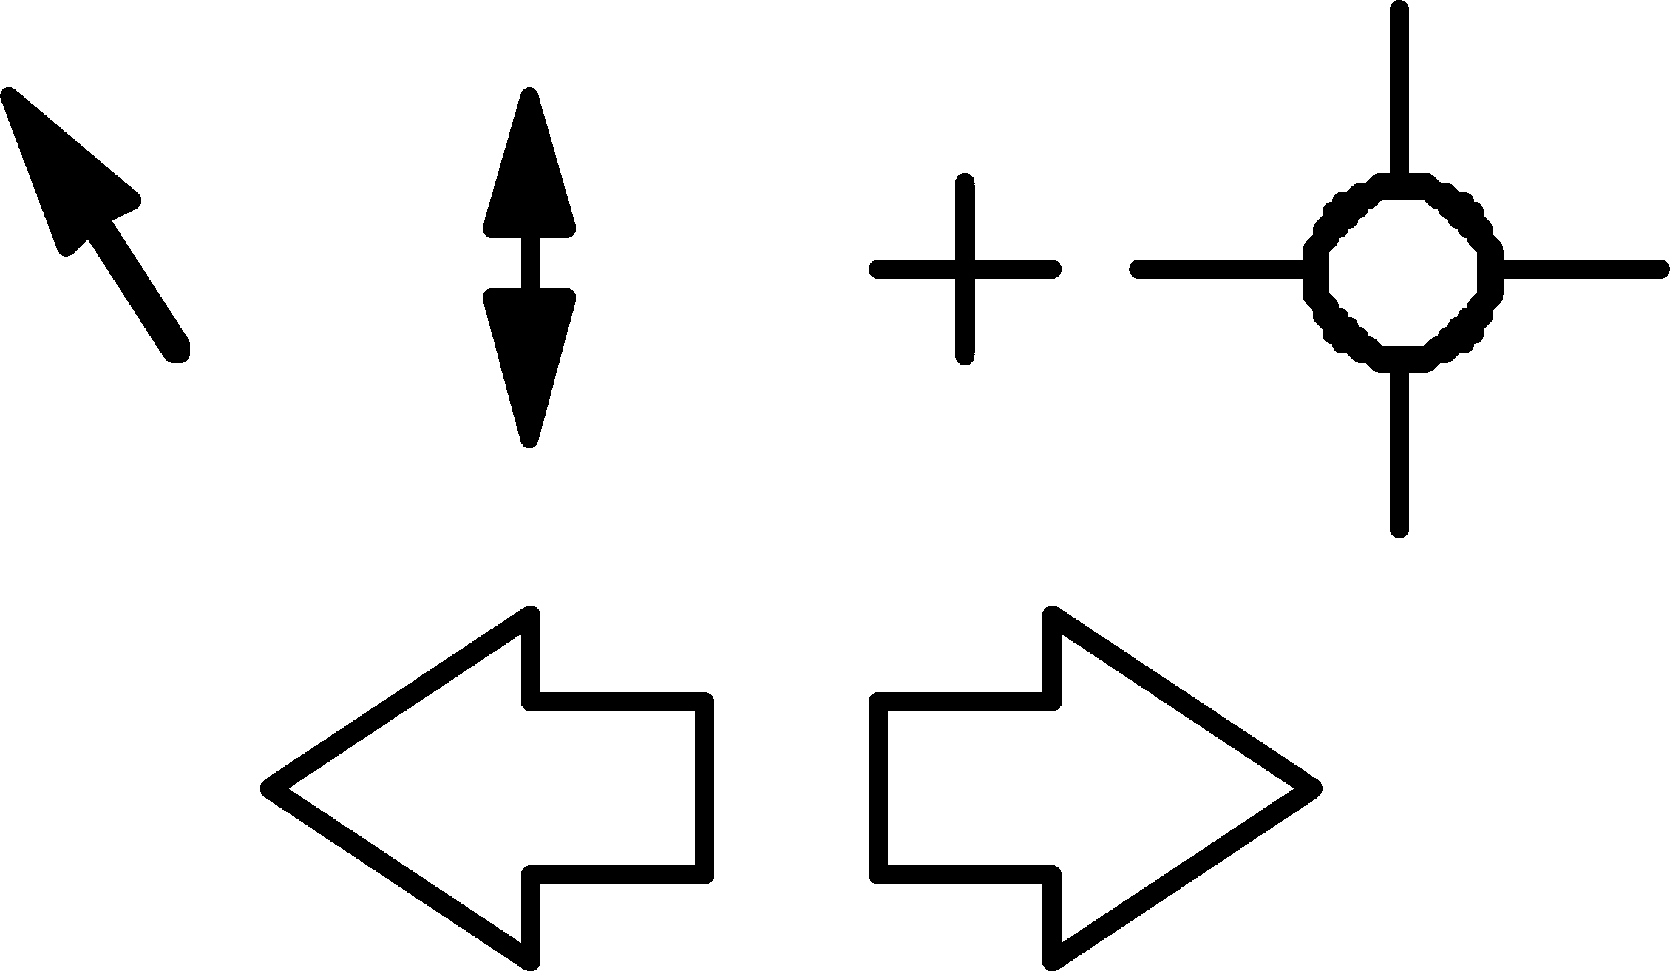
Pointers
important component
  WIMP style relies on pointing and selecting things
uses mouse, trackpad, joystick, trackball, cursor keys or keyboard shortcuts
wide variety of graphical images

Slide 10
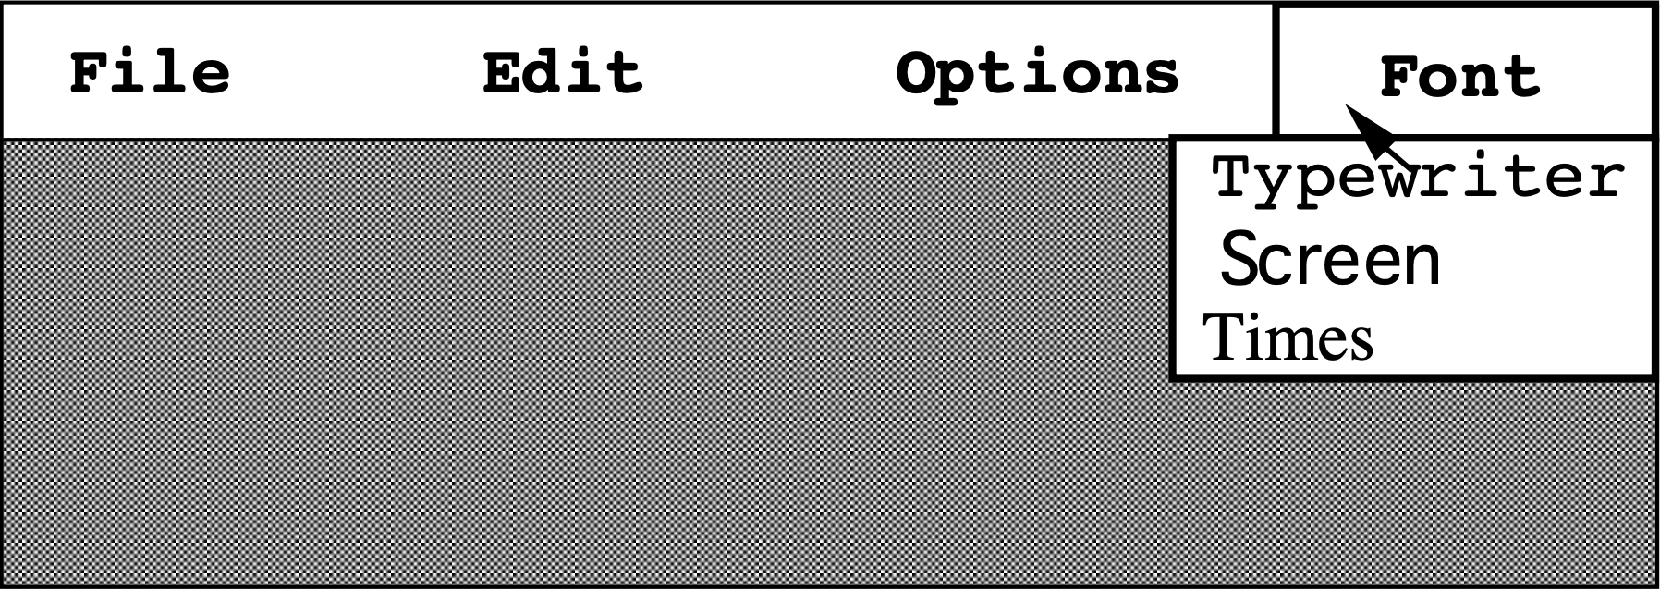
Menus
Choice of operations or services offered on the screen
Required option selected with pointer
problem – take a lot of screen space
solution – pop-up: menu appears when needed

Slide 11
Kinds of Menus
Menu Bar at top of screen (normally), menu drags down
  pull-down menu - mouse hold and drag down menu
  drop-down menu - mouse click reveals menu
  fall-down menus - mouse just moves over bar!
Contextual menu appears where you are
  pop-up menus - actions for selected object
  pie menus - arranged in a circle
    easier to select item (larger target area)
    quicker (same distance to any option)
    … but not widely used!

Slide 12
Why are pie menus fast?
QUIZ
2 min · remember Fitts’ law from Week 1
The cursor starts at the dot. Which menu gets you to ‘Share’ faster — and why?
A Linear pop-up menu
B Pie menu
Your answer
A or B?
Use the two Fitts levers:
D = distance to target
W = width of target
Cut
Share
Copy
Rename
Cut
Paste
Delete
Delete
Copy
Rename
Share
Paste
Notes:
QUIZ, 2 minutes. Recall Week 1: MT = a + b·log2(D/W + 1). Ask for a show of hands for A vs B, then ask one student to justify it using D and W.

Slide 13
Why are pie menus fast?
ANSWERS
Fitts’ law explains it
The cursor starts at the dot. Which menu gets you to ‘Share’ faster — and why?
A Linear pop-up menu
B Pie menu
B is faster
Distance D: the same short hop to every item — no item is ‘at the bottom’.
Width W: each wedge widens as you move out; overshooting still lands inside.
So D/W is small for all six items → lower index of difficulty.
Cut
Share
Copy
Rename
Cut
Paste
Delete
Delete
Copy
Rename
Share
Paste
Notes:
Answer B. Slide 37 said pie menus are easier (larger target area) and quicker (same distance to any option) — that is exactly the two Fitts levers.
Why not everywhere? Labels get cramped beyond about 8 items, and they break the familiar list layout. Many games use them (weapon wheels) — ask who has seen one.

Slide 14
Menus extras
Cascading menus
  hierarchical menu structure
  menu selection opens new menu
  and so in ad infinitum
Keyboard accelerators
  key combinations - same effect as menu item
  two kinds
    active when menu open – usually first letter
    active when menu closed – usually Ctrl + letter
  usually different !!!

Slide 15
Menus design issues
which kind to use
what to include in menus at all
words to use (action or description)
how to group items
choice of keyboard accelerators

Slide 16
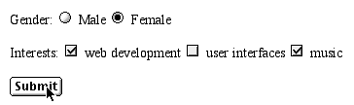
Buttons
individual and isolated regions within a display that can be selected to invoke an action
Special kinds
  radio buttons
  – set of mutually exclusive choices
  check boxes
  – set of non-exclusive choices

Slide 17
Radio button or check box?
QUIZ
2 min · a course-registration form: R or C for each field?
Semester
Fall
Spring
Summer
R / C
Electives to register (up to 3)
HCI
NLP
Cloud
Graphics
R / C
Hostel required?
Yes
No
R / C
Send notifications by
SMS
Email
App
R / C
Fee payment method
Bank challan
Card
Wallet
R / C
Notes:
QUIZ, 2 minutes. Students write R or C for each field. Ask them why the 'Hostel' field could be argued either way.

Slide 18
Radio button or check box?
ANSWERS
radio = pick exactly one · check box = pick any number
Semester
Fall
Spring
Summer
RADIO
Electives to register (up to 3)
HCI
NLP
Cloud
Graphics
CHECK BOX
Hostel required?
Yes
No
RADIO
Send notifications by
SMS
Email
App
CHECK BOX
Fee payment method
Bank challan
Card
Wallet
RADIO
Notes:
Answers: Semester R, Electives C, Hostel R (a single check box 'I need a hostel room' also works), Notifications C, Payment R.
'Up to 3' electives is a check box plus a rule the form must enforce and explain — a good example of error prevention.

Slide 19
Toolbars
long lines of icons …
… but what do they do?
fast access to common actions
often customizable:
  choose which toolbars to see
  choose what options are on it

Slide 20
Palettes and tear-off menus
Problem
menu not there when you want it
Solution
palettes – little windows of actions
  shown/hidden via menu option
  e.g. available shapes in drawing package
tear-off and pin-up menus
  menu ‘tears off’ to become palette

Slide 21
Dialogue boxes
information windows that pop up to inform of an important event or request information.
  e.g: when saving a file, a dialogue box is displayed to allow the user to specify the filename and location. Once the file is saved, the box disappears.

Slide 22
Fix this dialog box
LIVE EXERCISE
3 min · pairs · rewrite this dialog on paper
Warning
Your task
1. If you click ‘Yes’, is your work saved or lost?
2. What is the difference between ‘OK’ and ‘Yes’?
3. Rewrite the title, the message and the buttons.
Hint: this is a gulf of execution AND of evaluation in one small box.
!
Do you not want to discard the unsaved changes to the document before exiting?
Yes
No
Cancel
OK
Notes:
LIVE EXERCISE, 3 minutes in pairs. Let them struggle with question 1 — nobody can answer it confidently, which is the point.
Collect two redesigns on the board before revealing.

Slide 23
Fix this dialog box
ANSWERS
one good redesign
Save changes to Assignment3.docx?
What changed
Title names the object and the question.
No double negatives.
Says the consequence in plain words.
Buttons are verbs — you can answer without reading the text.
Default (bold) is the safe action; Cancel always escapes.
?
Your changes will be lost if you don’t save them.
Save
Don’t save
Cancel
Notes:
One good redesign. The same pattern is used by most modern word processors: Save / Don't save / Cancel.
Link to slide 47: this is a modal dialog — justified here because the step is essential (data loss), but use modality with care.

Slide 24
interactivity
easy to focus on look
what about feel?

Slide 25
Speech–driven interfaces
rapidly improving …
… but still inaccurate
how to have robust dialogue?
… interaction of course!
e.g. airline reservation:
reliable “yes” and “no”
+ system reflects back its understanding
“you want a ticket from New York to Boston?”

Slide 26
Look and … feel
WIMP systems have the same elements:
windows, icons., menus, pointers, buttons, etc.
but different window systems
… behave differently
  e.g. MacOS vs Windows menus
appearance + behaviour = look and feel

Slide 27
Initiative
who has the initiative?
old question–answer – computer
WIMP interface – user
WIMP exceptions …
pre-emptive parts of the interface
modal dialog boxes
  come and won’t go away!
  good for errors, essential steps
  but use with care

Slide 28
Error and repair
can’t always avoid errors …
… but we can put them right
make it easy to detect errors
… then the user can repair them
hello, this is the Go Faster booking system
what would you like?
(user) I want to fly from New York to London
you want a ticket from New York to Boston
(user) no
sorry, please confirm one at a time
do you want to fly from New York
(user) yes
… … …

Slide 29
Be the booking system
LIVE EXERCISE
5 min · pairs · role-play, then swap roles
Student A — the booking system
You are a speech-driven train-booking line.
You may only speak short sentences.
Mishear ONE thing on purpose (e.g. Karachi → Quetta).
Confirm every item before you book.
Student B — the caller
Your goal: 2 seats, Lahore → Karachi, Friday evening.
After your first sentence you may answer only ‘yes’ or ‘no’.
Notice when and how you catch the error.
Debrief
How many turns did the booking take? · When was the misheard city caught? · Would ‘confirm one at a time’ annoy an expert caller?
Notes:
LIVE EXERCISE, 5 minutes. Pairs; 2 minutes per role, 1 minute debrief.
Point back to slide 48: the system cannot avoid errors, but by reflecting back its understanding it makes errors easy to detect, and 'yes/no' is recognised reliably.
Everyday example: bank phone lines that read your request back to you before acting.

Slide 30
Context
Interaction affected by social and organizational context
other people
  desire to impress, competition, fear of failure
motivation
  fear, allegiance, ambition, self-satisfaction
inadequate systems
  cause frustration and lack of motivation

Slide 31
Why won’t they use it?
THINK-PAIR-SHARE
3 min · pairs
Case: the university launches an online leave-application portal. A month later most staff still hand in paper forms. Why?
Other people
desire to impress, competition, fear of failure
Motivation
fear, allegiance, ambition, self-satisfaction
Inadequate system
frustration, lack of motivation
your reasons…
your reasons…
your reasons…
Notes:
THINK-PAIR-SHARE, 3 minutes. Each pair finds at least one reason per column.
Typical answers — Other people: the boss still signs paper; nobody wants to be the first to 'get it wrong' online. Motivation: paper is familiar; no personal benefit shown. Inadequate system: login problems, no mobile version, no confirmation that the leave was approved.
Takeaway: a usable system can still fail because of its social and organisational context.

Slide 32

Experience, engagement and fun
designing experience
physical engagement
managing value

Slide 33
Experience?
home, entertainment, shopping
  not enough that people can use a system
  they must want to use it!
psychology of experience
  flow (Csikszentimihalyi)
  balance between anxiety and boredom
education
  zone of proximal development
  things you can just do with help
wider ...
  literary analysis, film studies, drama

Slide 34
Where is your flow?
POLL
1 min · hands up · where are you on this chart?
↑ challenge
Vote with your hand
1. Name an app or game where you lost track of time. What kept you in the channel?
2. Your first week learning a new programming language: anxiety, flow or boredom?
3. The university portal: which region is it in — and should it try to give you ‘flow’?
ANXIETY
FLOW
BOREDOM
your skill →
Notes:
POLL, 1–2 minutes. Draw attention to the channel: challenge rises as skill rises (Csikszentmihalyi).
Games are designed to keep you in it with levels; learning tools use the 'zone of proximal development' — tasks you can just do with help.
Q3 is a trap: a fee portal should be efficient and calm, not 'engaging'. Experience design must fit the purpose.

Slide 35
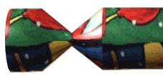
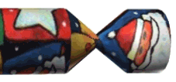
Designing experience
real crackers
  cheap and cheerful!
  bad joke, plastic toy, paper hat
  pull and bang

Slide 36
Designing experience
virtual crackers
  cheap and cheerful
  bad joke, web toy, cut-out mask
  click and bang

Slide 37


Designing experience
virtual crackers
  cheap and cheerful
  bad joke, web toy, cut-out mask
  click and bang

Slide 38




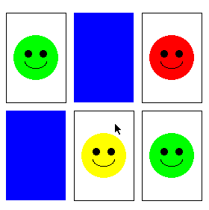
how crackers work
fill in web form
sender
To: wxv
From: ..
receive email
recipient
closed
cracker page
open
message
watches
progress
recipient clicks
cracker opens ...
very slowly
open
cracker page
joke
links
sender
mask
web toy

Slide 39
The crackers experience
real cracker virtual cracker
Surface elements
design cheap and cheerful simple page/graphics
play plastic toy and joke web toy and joke
dressing up paper hat mask to cut out
Experienced effects
shared offered to another sent by email message
co-experience pulled together sender can't see content until opened by recipient
excitement cultural connotations recruited expectation
hiddenness contents inside first page - no contents
suspense pulling cracker slow ... page change
surprise bang (when it works) WAV file (when it works)

Slide 40
Design a digital Eidi
CASE PUZZLE
5 min · groups of 3 · like the crackers table, for Eid
Real Eidi (cash)
Digital Eidi — your design
design
Crisp new notes in a decorated envelope
play
Guessing and counting the notes
dressing up
New clothes, Eid greetings
shared
Handed over in person by an elder
co-experience
Whole family present, cousins compare
excitement
The build-up of Eid morning
hiddenness
The envelope is sealed
suspense
Opening the envelope slowly
surprise
The amount — and the new notes
Blue rows = surface elements · green rows = experienced effects (from the crackers slide)
Notes:
CASE PUZZLE, 5 minutes, groups of three. This is the crackers analysis (slide 56) moved to a Pakistani tradition.
Groups design the right-hand column. Push for 'co-experience' and 'suspense' — those are the hardest to carry over to a screen, exactly as with the virtual cracker.

Slide 41
Design a digital Eidi
ANSWERS
one group’s design
Real Eidi (cash)
Digital Eidi — your design
design
Crisp new notes in a decorated envelope
Animated envelope card with an Eid theme
play
Guessing and counting the notes
Tap-to-open or scratch-card reveal
dressing up
New clothes, Eid greetings
Personal message or voice note from the sender
shared
Handed over in person by an elder
Sent to the recipient with a notification
co-experience
Whole family present, cousins compare
Family-group reveal; thank-you sticker back
excitement
The build-up of Eid morning
“You’ve received Eidi from Phuppo!”
hiddenness
The envelope is sealed
Amount hidden until opened
suspense
Opening the envelope slowly
Slow opening animation
surprise
The amount — and the new notes
Amount and message revealed together
Blue rows = surface elements · green rows = experienced effects (from the crackers slide)
Notes:
One group's design. Ask: which effect is weakest in the digital version? (Usually co-experience — the elder is not there to see your face.)
Design idea some groups propose: the elder records a short video that plays as the envelope opens.

Slide 42
Physical design
many constraints:
  ergonomic – minimum button size
  physical – high-voltage switches are big
  legal and safety – high cooker controls
  context and environment – easy to clean
  aesthetic – must look good
  economic – … and not cost too much!

Slide 43
Design trade-offs
constraints are contradictory … need trade-offs
within categories:
  e.g. safety – cooker controls
    front panel – safer for adult
    rear panel – safer for child
between categories
  e.g. ergonomics vs. physical – MiniDisc remote
    ergonomics – controls need to be bigger
    physical – no room!
    solution – multifunction controls & reduced functionality

Slide 44
Name the constraint
QUIZ
2 min · name the constraint behind each design
1
A hospital keyboard must survive disinfectant wipes
2
A phone’s power button must be at least fingertip-sized
3
Stove knobs are placed where toddlers can’t reach them
4
A cheap TV remote uses rubber keys, not metal
5
The switch on a tube-well motor must be large to carry the current
6
A smartwatch must look like jewellery
Choose from: Ergonomic · Physical · Legal & safety · Context & environment · Aesthetic · Economic
Notes:
QUIZ, 2 minutes. Categories from slide 57. Answers on the next slide.

Slide 45
Name the constraint
ANSWERS
1
A hospital keyboard must survive disinfectant wipes
Context & environment
2
A phone’s power button must be at least fingertip-sized
Ergonomic
3
Stove knobs are placed where toddlers can’t reach them
Legal & safety
4
A cheap TV remote uses rubber keys, not metal
Economic
5
The switch on a tube-well motor must be large to carry the current
Physical
6
A smartwatch must look like jewellery
Aesthetic
Real products face several at once — which is where the trade-offs come from.
Notes:
Answers as shown. Follow-up: the tube-well switch is also a safety issue — ask for another example where two categories pull in different directions (e.g. the MiniDisc remote on slide 58: ergonomics vs physical size).

Slide 46
Fluidity
do external physical aspects reflect logical effect?
  related to affordance (chap 5)
  logical state revealed in physical state?
      e.g. on/off buttons
  inverse actions inverse effects?
      e.g. arrow buttons, twist controls

Slide 47
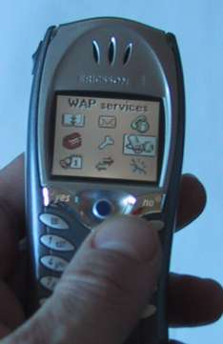
inverse actions
yes/no buttons
  well sort of
‘joystick’
also left side control

Slide 48
spring back controls
one-shot buttons
joystick
some sliders
good – large selection sets
bad – hidden state

Slide 49
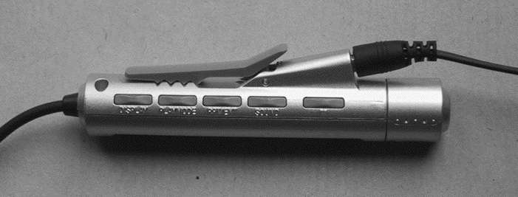
a minidisk controller
twist for track movement
pull and twist for volume
– spring back
– natural inverse for twist
series of spring-back controls
each cycle through some options
–natural inverse back/forward

Slide 50
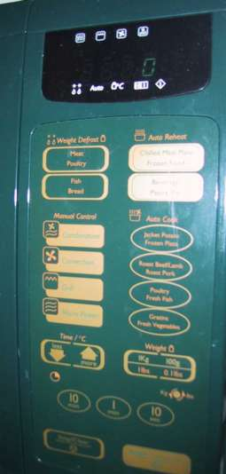
physical layout
controls:
logical relationship
~ spatial grouping

Slide 51
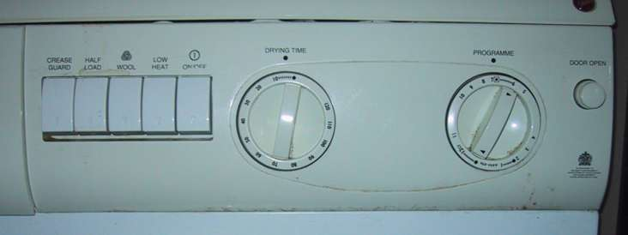
compliant interaction
state evident in
mechanical buttons
rotary knobs reveal internal state and can be controlled by both user and machine

Slide 52
Physical design hunt
LIVE EXERCISE
3 min · use a device you have with you right now
Device
Is the logical state visible in the physical state?
Do inverse actions give inverse effects?
Any spring-back controls? What do they hide?
Ceiling-fan regulator
Yes — knob position = speed
Yes — turn back = slower
No
AC remote
No — the state lives in the AC unit
Yes — ▲ / ▼ temperature
All buttons spring back: is ‘swing’ on?
Your device:
Your device:
Try: your phone’s volume buttons, a laptop lid, a pen click, the light switches, a water tap.
Notes:
LIVE EXERCISE, 3 minutes. Students fill two rows with devices they have on them.
Good finds: phone volume buttons (spring back, state only on screen), a clicky pen (state visible — tip out), a laptop lid (fluid: open = on).
Connect to slides 59–64: fluidity, spring-back controls and compliant interaction.

Slide 53
Managing value
people use something
ONLY IF
it has perceived value
AND
value exceeds cost
BUT NOTE
exceptions (e.g. habit)
value NOT necessarily personal gain or money

Slide 54
Weighing up value
value
    helps me get my work done
    fun
    good for others
cost
    download time
    money £, $, €
    learning effort

Slide 55
Discounted future
in economics Net Present Value:
  discount by (1+rate)^{years to wait}
in life people heavily discount
  future value and future cost
  hence resistance to learning
  need low barriers
  and high perceived present value

Slide 56
Would you switch?
POLL
1 min vote, then 2 min to calculate
A new note-taking app saves you 10 minutes a week, but learning it costs 3 hours this weekend. Do you switch?
A Yes, switch now
B No, not worth it
C Maybe after exams
Then calculate: how much time do you save by the end of this 16-week semester? By the end of one year?
Is your vote consistent with the numbers?
Notes:
POLL, 1 minute vote, 2 minutes to calculate in pairs. Record the vote on the board.

Slide 57
Would you switch?
ANSWERS
the arithmetic
A new note-taking app saves you 10 minutes a week, but learning it costs 3 hours this weekend. Do you switch?
Cost now
3.0 h
Saving by end of semester (16 wk)
2.7 h
Saving after one year (52 wk)
8.7 h
Design lesson: people discount future value heavily, so lower the barrier today — import old notes automatically, a 5-minute start — and show value in the first session.
Notes:
Semester: 16 × 10 = 160 min ≈ 2.7 h — less than the 3 h cost. Year: 52 × 10 = 520 min ≈ 8.7 h — clearly worth it.
Yet most students vote B or C even when they plan to use notes all year: that is the 'discounted future' of slide 67. Designers respond with low barriers and high present value.

Slide 58
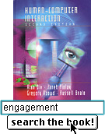
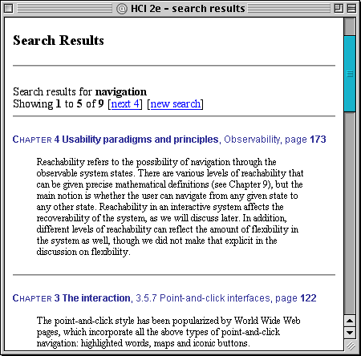
example – HCI book search
value for people who have the book
helps you to look up things
      chapter and page number
value for those who don’t …
sort of online mini-encyclopaedia
      full paragraph of context
… but also says “buy me”!!
… but also says “buy me”!!

Slide 59
Exit ticket
QUIZ
3 min · exit ticket · write a, b or c and hand it in
1
A modal dialog box is best used for…
a) every notification
b) errors and essential steps
c) toolbars
2
Radio buttons are for…
a) mutually exclusive choices
b) non-exclusive choices
c) free text
3
In ‘look and feel’, feel means…
a) the colours
b) the behaviour
c) the font
4
Flow lies between…
a) anxiety and boredom
b) skill and money
c) input and output
5
People use a system only if its perceived value…
a) is free
b) exceeds its cost
c) is fun
Notes:
Exit ticket, 3 minutes. Collect at the door.

Slide 60
Exit ticket
ANSWERS
check yourself
1
A modal dialog box is best used for…
a) every notification
b) errors and essential steps
c) toolbars
2
Radio buttons are for…
a) mutually exclusive choices
b) non-exclusive choices
c) free text
3
In ‘look and feel’, feel means…
a) the colours
b) the behaviour
c) the font
4
Flow lies between…
a) anxiety and boredom
b) skill and money
c) input and output
5
People use a system only if its perceived value…
a) is free
b) exceeds its cost
c) is fun
Notes:
Answers: 1b, 2a, 3b, 4a, 5b. Close by linking back to Lecture 1: every element today either narrows a gulf or widens it.

